Slide 1
Capstone Project - The Battle of Neighborhood
Applied data science capstone

Slide 2
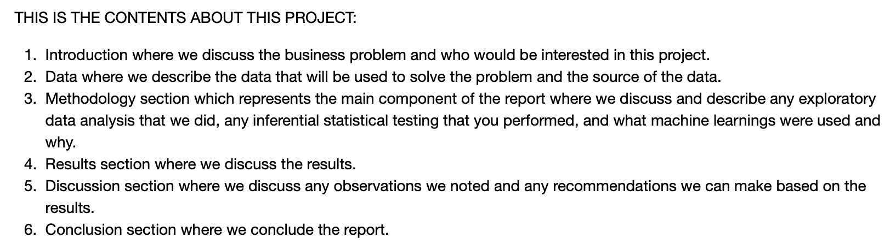
Contents

Slide 3
1. Introduction: Business Problem
In this project, we will try to find an optimal location for a new Asian restaurant in London. Specifically, this report will be targeted to stakeholders interested in starting an **business for Asian restaurant in London, UK.
As Asians are increasing more and more in London, there are not enough stores for Asian restaurants. Since there are lots of restaurants for different countries' people in London, we will try to detect **areas with no Asian restaurants in vicinity**. We would also prefer locations **as close to city center as possible**, assuming that first two conditions are met.
We will use our data science powers to generate a few most promising neighborhoods based on this criteria. Advantages of each area will then be clearly expressed so that best possible final location can be chosen by stakeholders.

Slide 4
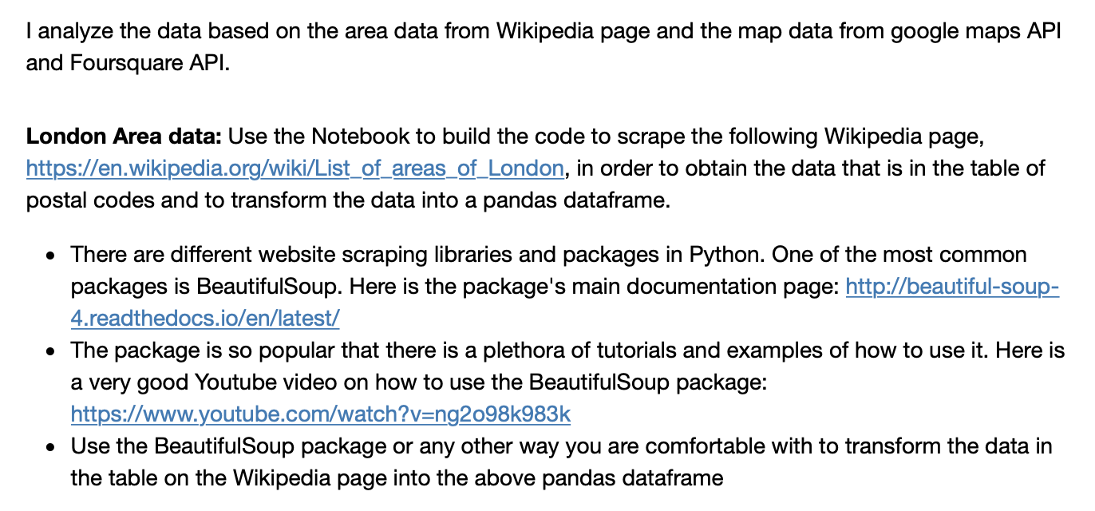
2. DATA Section

Slide 5
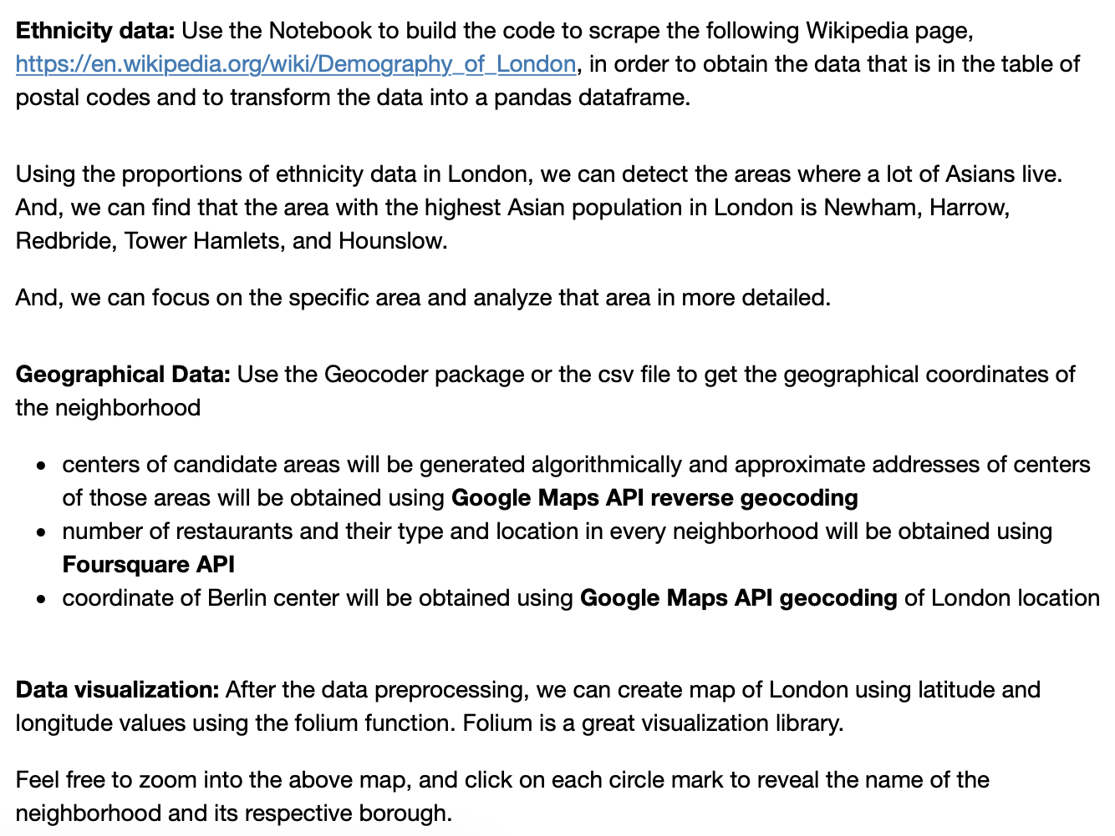
2. DATA Section

Slide 6
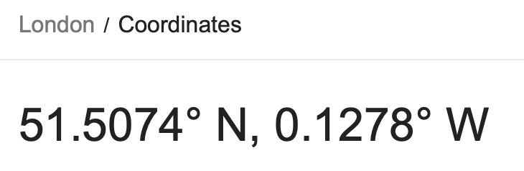
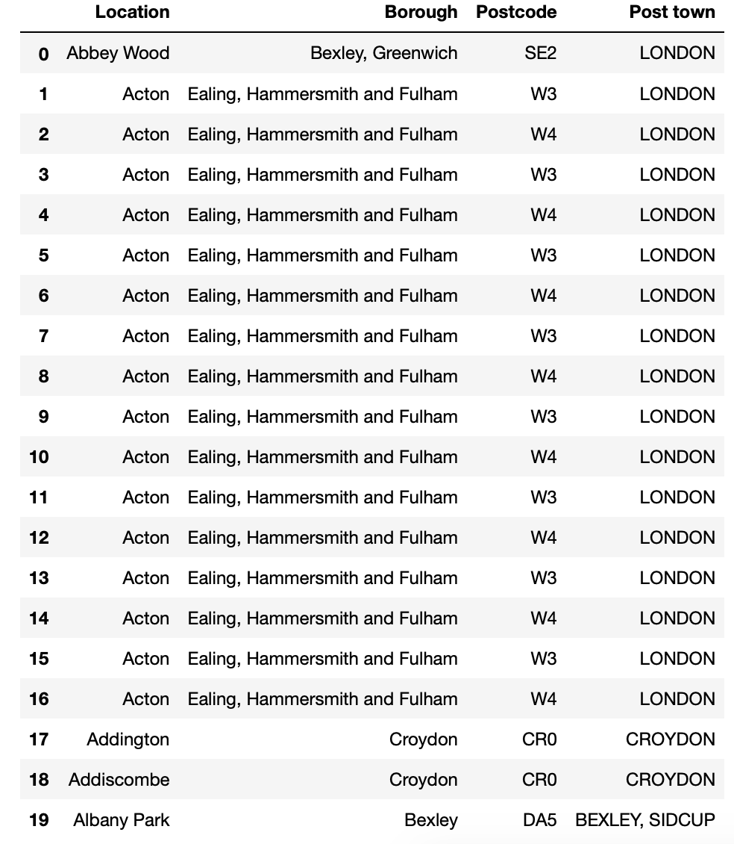
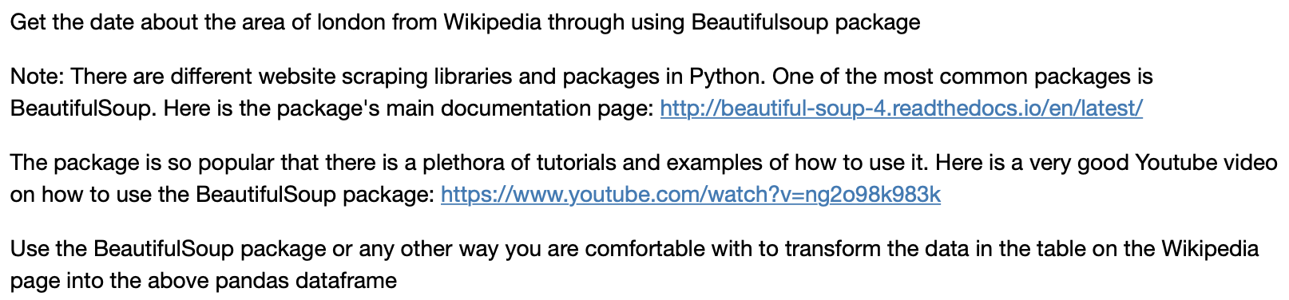
2. DATA Section – Area data

Slide 7
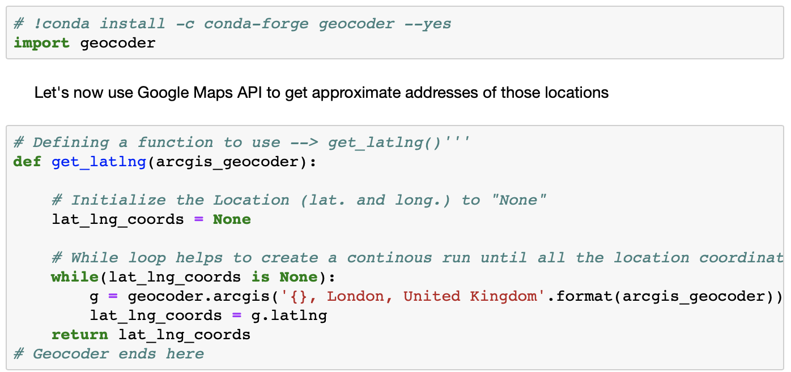
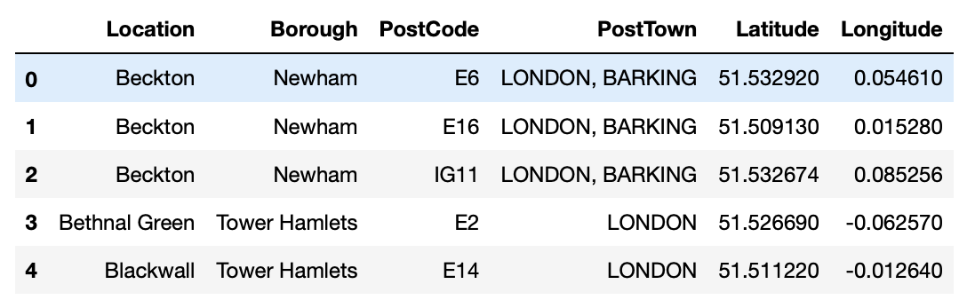
2. DATA Section – Geographical data
By using the geocoder function, we can get the longitude and latitude data for each location

Slide 8
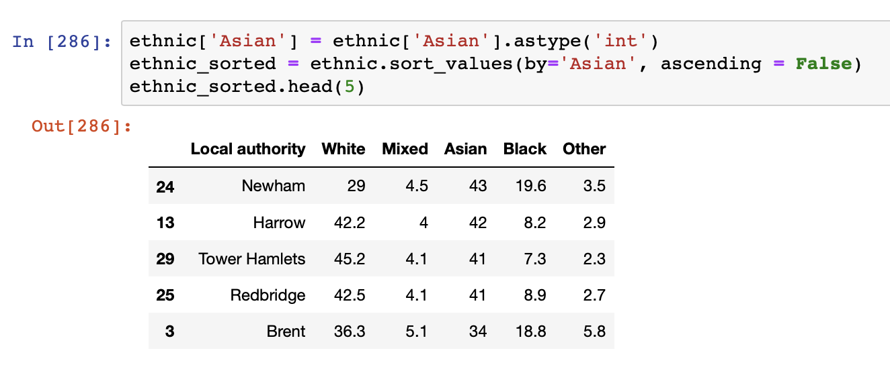
2. DATA Section – Ethnicity data
We can detect the areas where a lot of Asians lived.
The Area with the highest Asian population in London is the Newham, Harrow, Redbride, Tower Hamlets, and Hounslow.

Slide 9
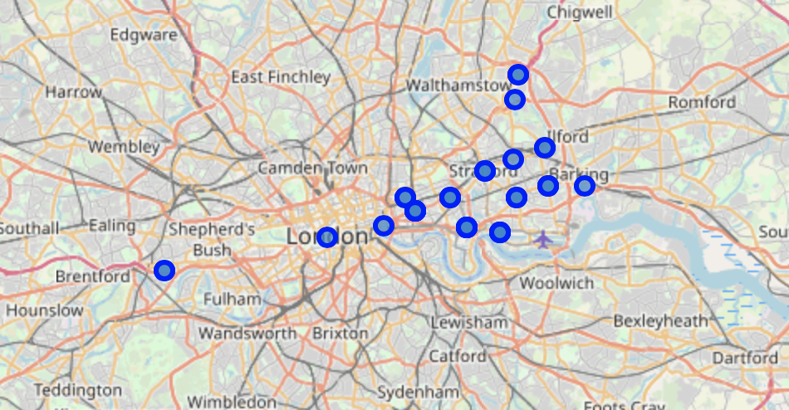
2. DATA Section – Data visualization
After the data preprocessing, we can create map of London using latitude and longitude values using the folium function.
Folium is a great visualization library. Feel free to zoom into the above map, and click on each circle mark to reveal the name of the neighborhood and its respective borough.

Slide 10
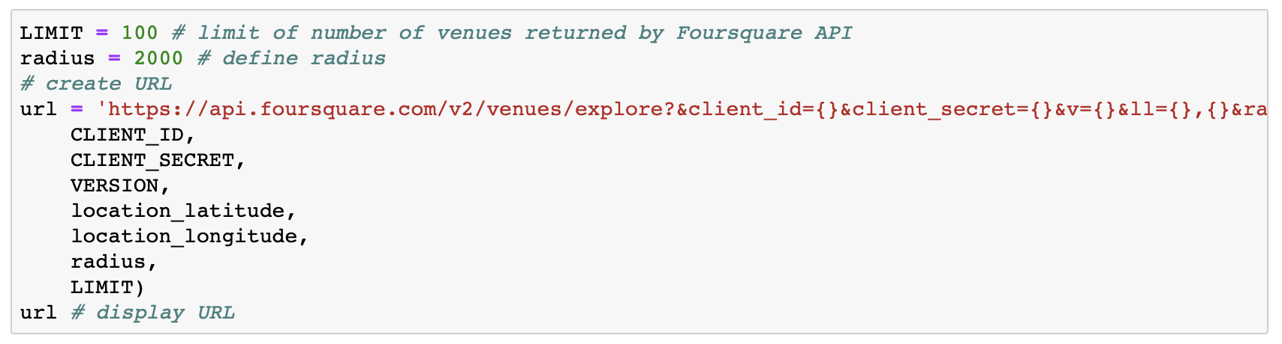
2. DATA Section – foursquare API
Through connecting to Foursquare, we can get the venue for each neighborhood. After getting all the neighborhoods, we connect to Foursquare API to gather information about venues for each neighborhood.

Slide 11
3. Methodology
In this project, we will direct our efforts on detecting areas of London. We will limit our analysis to area around city center. In first step we have collected the required data: location and type (category) of every restaurant near London center. And, we will focus on most promising areas and within those create clusters of locations. We will present map of all such locations but also create clusters (using **k-means clustering) of those locations to identify general zones / neighborhoods / addresses which should be a starting point for final 'street level' exploration and search for optimal venue location by stakeholders.

Slide 12
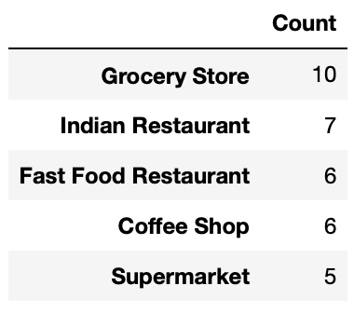
4. Analysis – Single neighborhood
A single Neighborhood within the London area where a lot of Asians lived are examined by using the Foursquare API.
Let's get the top 100 venues that are in Beckton (Borough: Newham) within a radius of 2000 meters.
When we check the top 5 venues at the Beckton area, there are Indian restaurants and fast food restaurant there.

Slide 13
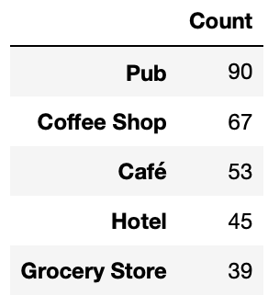
4. Analysis – Multiple neighborhoods
Next, Let’s analyze the multiple Neighborhoods
getNearbyVenues function is used to get the venues for each neighborhood.
There is no restaurant among the top 5 venues.

Slide 14
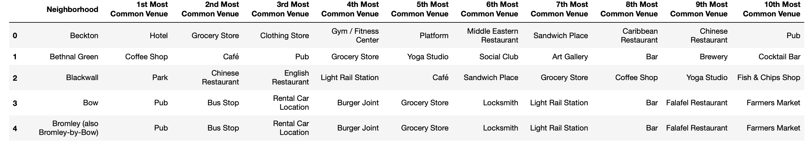
4. Analysis – Each neighborhood
And, let’s analyze each neighborhoods
One hot encoding function is used to check the venues in each neighborhood.
There are 10 most common venues in each neighborhood.

Slide 15
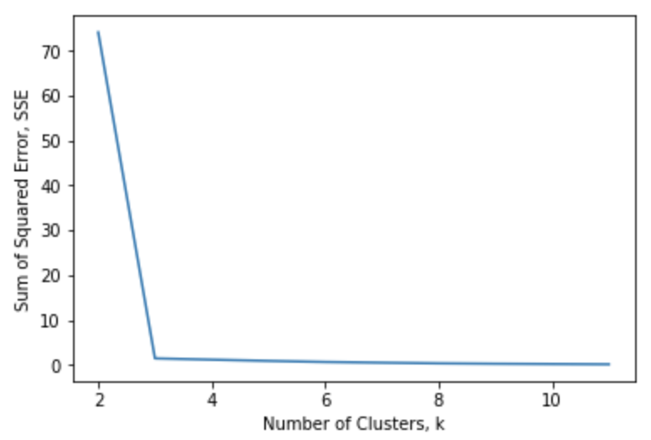
4. Analysis – K-means clustering
Applying K-means clustering
- Before creating K-means clustering, we are needed to check the elbow method and get the best K.
Using the elbow method, we can select the best number of k. So, k is 3..

Slide 16
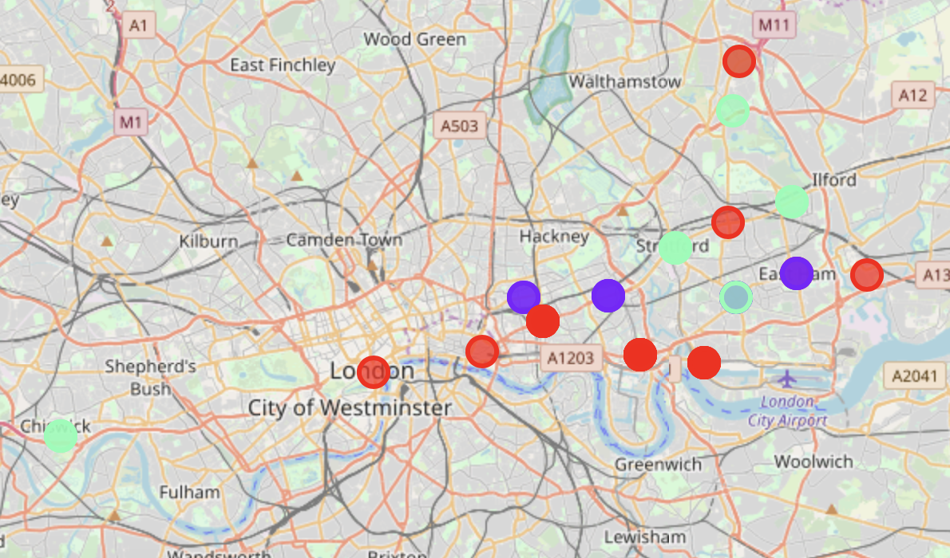
4. Analysis - K-means clustering
Visualize the clusters by using the folium function (Cluster 1: Red, Cluster 2: Violet, Cluster 3: Green)

Slide 17
5. Result and Discussion
After the cluster analysis, Cluster 1 is the Cultural & Tourist area and Hub (Hotel and Park are popular), cluster 2 falls within more of a main residential district with Pubs and cluster 3 is much more residential area and there are pubs and café there.
In Newham area where many Asians lived, Indian restaurants are popular.
In conclusion, pubs and hotels are popular in the Asian district in London. And, Most popular venue type in Downtown London is Pubs.
London is the capital and the largest city with a high population density in a small area. There are 32 boroughs in London. As London is considered as one of the world's most global cities, there are many creative approaches in clustering and classification studies.
The K-means algorithm are used for clustering study. Through using the Elbow method, the best number of k is 3. For future study, more data set can be added and more details of the neighborhood can also be included.
When we recommend the zones where stakeholders can consider for opening their restaurants, we need to check if there is no nearby competition. and the conditions in that area are related with the restaurants in which they try to open.

Slide 18
6. Conclusion
Cluster | Description
Cluster 1 | The most common venue type is Hotel and Park.
Cluster 2 | The most common venue type is Pub.
Cluster 3 | The most common venue type is Pub and Café.
The purpose of the project is to find out areas in London center with low number of Asian restaurants in order to help stakeholders narrowing down the candidate of best location for new Asian restaurants.
So, after the analysis of the venues in London, we can recommend our stakeholders that if the Asian restaurants are open in the cluster 1 area, it will be successful. This is because there are a lots of asian restaurant (Especially Chinese restaurant) and china restaurants (3rd Most Common Venue) are already popular in cluster 2 area. Also, the cluster 3 is a tourist area, it is not good for asian restaurants. In the areas which belongs to the cluster 1, there is no competitor for Asian restaurants and a lot of asian lived there so these areas are good place ofr new Asian restaurants.
And, if there were more data about the housing price, traffic access, ratings or so on, we can get better understanding of the results and give the good insights for stakeholders.

Slide 19
7. REcommendation
When stakeholders start a business in a big city, it is needed to understand what the district needed. If they understand this clearly, people can achieve better outcomes through their analysis. There are different approaches to analyze the big cities.
The techniques which I used in London, can be used to analyze the different big cities' cases. And, these skills are useful to analyze the other cities.
And, we need to remember that "There is no free lunch", which means that there are a lot of methods to analyze the dataset and according to these techniques, the results are very different so we need to try diverse different methods to figure out what we need and we can find the best outcomes.

Slide 20
Thank You
Any Questions?

